Slide 1

Subject : Calculus and Linear Algebra
Subject Code :18MAB101T

Slide 2
APPLICATIONS OF MATHEMATICS IN ENGINEERING FIELDS

Slide 3
Team members:
1. Ms. Sobiya T - 21EC007
2. Ms. Sharmila S - 21EC063
3. Ms. Vinotha P - 21EC299
4. Ms. Thanushya R P R - 21EC345
5. Ms. Thirisha G - 21EC271
6. Ms. Subashini M - 21EC322
7. Ms. Sruthikaa K V - 21EC314
Guided by
Ms.J Hellan Priya,
Assistant Proffessor of
Mathematics in ECE.

Slide 4
Synopsis
Introduction
Mechanical Engineering.
Architectural Engineering.
Robotics Engineering.
Astronomy Engineering.
Computer Science & Engineering.
Electronics & Communication Engineering.
Electrical & Electronics Engineering.
Conclusion.

Slide 5
Introduction
In Engineering, Math and science are the tools that are used within the engineering design process.
Math is a tool to create Mathematical models that describe physical phenomena and as a tool to evaluate the merit of different possible solutions.

Slide 6
Mechanical Engineering
Mechanical engineers use Maths with analytical and problem solving abilities to develop or repair new machines.
The general study of the relationship between the motion forces and energy is called Mechanics.
Examples of application of managing mechanics :
Speed is measured as distance travelled / time taken.
Force accepted = Mass * Accelerations.
Gravity of earth is 9.8 meters / Second.

Slide 7
Continued….
In Mechanical engineering, Mathematics is important because it is required to solve problems, to analyze Mathematic relations and in using the Law of nature, which are Mathematical expressions.
Mathematics plays a crucial role in deriving Mechanical relationship.

Slide 8
Continued….
Like many engineering fields, mechanical engineering has many subjects which have a lot of mathematics in their contents, which should be properly called as engineering mathematics.
Mechanics of Materials, Thermodynamics, Heat Transfer and Internal combustion engines are examples of the subjects.

Slide 9
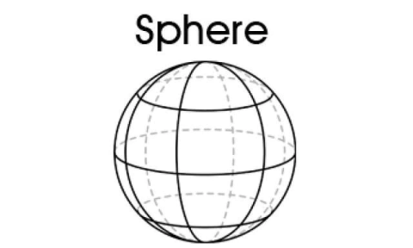
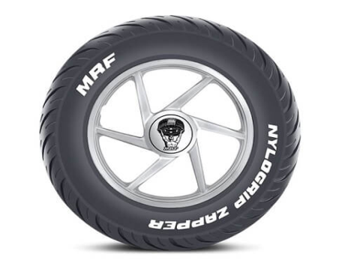
Shapes in cars
Some examples of shapes in green cars include :-
Sphere :
Tyers of a car.
Circle :
Steering wheel.
Quadrilateral :
Solar panel of green car, for e.g. Toyota Prius.
Bonnet of car, door of a car Windshield and windows of a car.
Number plate of your car and its mudflap.

Slide 10
Architectural Engineering
Trigonometry helps the architects to design a mathematical draft that a constructor can use for constructor purpose.
Mathematics is used architecture to design a images on a drawing and is needed to analyse this structure problems.
Geometric Algebra and Trigonometry all plays a crucial role in architectural design. Architectural apply this math forms to plan their blueprint or initial sketch design.

Slide 11
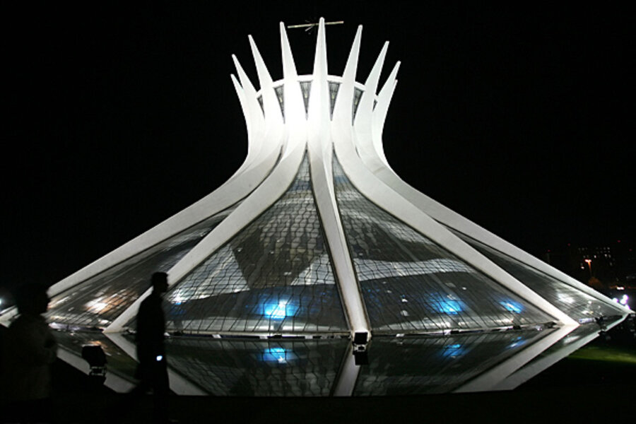

Architecture
The early Twentieth century movement modern architecture used Rectilinear Euclidean also called Cartesian Geometry.

Slide 12
Continued…
The architectural forms consists of putting this two directional tendencies together, using roof planes, wall planes and balconies, which either sides past or interest each other.
The goals of architecture include Aesthetics, Philosophy and meaning as well as function. Architecture uses the beauty and structure of Mathematics to achieve these goals.

Slide 13
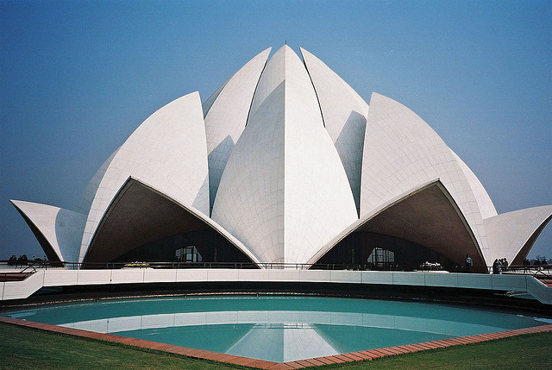
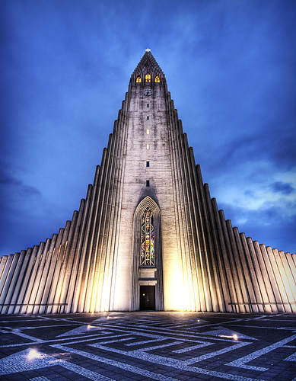
In this topic we think we should talk about what type of Maths is involved in construction like shapes, angles, sizes, 3D shapes. These buildings use everything in the given list.

Slide 14
Robotics Engineering
The term robot was first used in 1920 in a play called R.U.R
Robotics is a branch of Engineering that involves conception design manufacture and operation of robots.
Robotics research has been increasing exponential and making a new industrial revolution.

Slide 15
Concept of Mathematics in Robotics
Geometry.
Numerical analysis
Advanced Linear Algebra
Calculus

Slide 16
Need of Mathematics in Robotic Engineering :
The study of robotic manipulators requires knowledge of Linear Algebra.
Required knowledge of control theory, Laplace transform, linear time invariant system etc.
It use sensor under the field of Digital Signal Processing and Fourier analysis.

Slide 17
Importance of Mathematics in Robotics:
It performs a significant part in robotic modelling planning and execution.
The robotic scientist know how to deal with this complex equation and form a software framework to create more advanced function and functional robotics of the century.
In every aspects Maths plays a major and crucial role in every parts of life.

Slide 18
Vector Calculus in Robotics
Vector calculus in robotics for the research path Integration in robot and Navigation and path optimization technique using Vector Calculus. Further technology in vector graphics is a humanoid robot.

Slide 19
Astronomy
Astronomy is the study of the sun, moon, stars, planets, gas, galaxies, dust and other non - earthy bodies and phenomena.

Slide 20
How Mathematics is used in Astronomy?
Maths is used in astronomy to calculate routes for satellite, rockets and space probes.
Trigonometry in Astronomy:
Trigonometry is used to measure the distance to stars in the solar system the method of measuring distance in space is called Trigonometry Parallax.
Geometry in Astronomy
Geometry is used in astronomy to determine the properties of star and other objects in space.

Slide 21
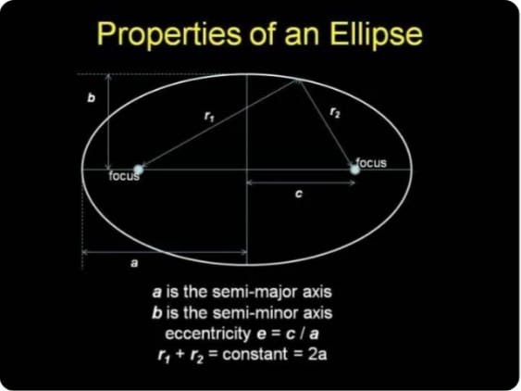

Slide 22
Applications of Mathematics in Computer Science and Engineering
Definition of Computer:
Device that perform operations.
Binary or Machine language - 0 and 1.
Computer understands binary language.

Slide 23
Continued…
Arithmetic and logic unit performs maths calculation like "+, -, * and /”
Logical operation like " =, >, <" is usually a comparison.

Slide 24
Examples of arithmetic operations
Addition : (4+3 = 7)
Subtraction : ( 4-3 =1)
Multiplication :(4x3 =12)
Division :( 4 ÷ 3 =1)

Slide 25
Continued….
Data packets - Unit of data in binary form.
IP Address - Numerical label in binary form
Cryptography - Security of data that use Permutation and Combination

Slide 26
Mathematics in Electronics And Communication Engineering
Electrical engineer design, develop, test, and supervise the manufacture of electrical equipment.
Some of this equipment includes electric motors; machinery controls, lighting, and wiring in buildings; automobile aircraft radar and navigation system; and power generation control and transmission devices used by electric utilities.

Slide 27
Applications :
The whole concept starts from Co-ordinate systems, Vector Algebra, Stokes theorem.
Computational electromagnetics which is very tough and need more knowledge of partial differential equations, numerical methods to solve coupled equations.
In many University Linear Algebra is a compulsory course for master's students in communication and signal processing.

Slide 28
WHAT MATH IS USED MOST IN ELECTRONICS ENGINEERING?
Measurement
Piping configuration.
Power and voltage calculation.

Slide 29
Measurements:
The simplest and most common use of math in Electrical Engineering is measurement.
Wiring must be connected seamlessly and in the appropriate places in a finished structure.
Electricians may need to measure room dimension wiring length, and other variable to determine the best placement for specific components.
Electricians may employe, fundamental arithmetic methods like Addition and Subtraction as well as simple Algebraic Linear Function.

Slide 30
PIPING CONFIGURATION:
When initial measurement have been take on electricians may need to use more complex math to determine the correct component angles, or pipes and circuits.
To determine the correct component angles, an electrician may use Geometry or Trigonometry principles.
Geometry principles may also be used to ensure correct configuration. It is also used when electricians draw up blueprints or building plans.

Slide 31
Mathematics in Electrical and Electronics Engineering
All branches of engineering have same common syllabus of Mathematics but Electrical and Electronics Engineering use Mathematics maximum among all branches in their specialist courses.

Slide 32
Maths used in Electrical Engineering:
Electrical engineer use Math many ways in their career. They use Math to test electrical equipment.
They use Math to calculate amp and volt requirements for Electrical projects.
They use Math in creating computer simulations and designs for new product.

Slide 33
In statistics :
Starting from designing a product making a finished one and making it work at every step an engineer needs help of statistic in some form or other.
Calculus :
Calculus is used by engineers to determine rates of change or state by which factors, such as acceleration or weight, change.

Slide 34
Trigonometry:
Trigonometry is the science of measuring triangles.
Engineers may use plane trigonometry to determine the size irregularly shaped parcel of land
Eg: Spherical Trigonometry is used by Naval Engineers in ship design.

Slide 35
Applications of Electrical Engineer
Electronic engineers work transport networks, lightings, heating in ventilation, lift system.
Power generation and distribution, renewable energy, manufacturing and construction.

Slide 36
Some Electrical Components
Fixed voltage source (like a pump whose pressure is constant)
Variable voltage source (like a pump whose pressure you can adjust)
Resistor (like an obstruction in a pipe)

Slide 37
Conclusion:
Engineering + Maths = Everything
Engineering - Maths = Nothing

Slide 38
ANY QUESTIONS

Slide 39
Thank You!

